Slide 1
FreeSurfer Tutorial
27 June 2016

Slide 2
Schedule
9:00-9:10 | Breaking the Ice
9:10-9:45 | What is FreeSurfer? | Quick intro to FS and associated jargon
9:45-10:15 | Unix Tutorial | What is the terminal?
10:15-10:30 | break | Q&A – review
10:30-11:00 | Installation | Downloading and installing software + tutorial data
11:00-12:00pm | Exercises, Q&A | Sharing of tools, code and documentation for FreeSurfer

Slide 3
Materials & Resources
Google Drive (everything can be found here)
Documentation for today’s tutorial (have this printed out)
Surfer-gems (🏄 -💎)
FreeSurfer (link for FAQ & installation)

Slide 4
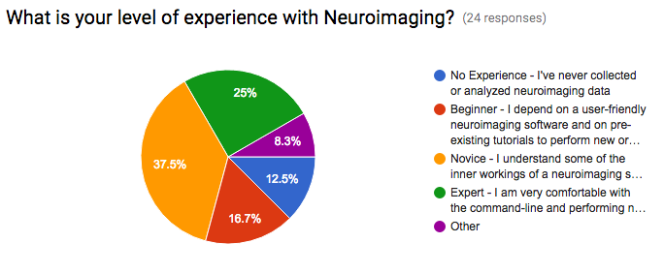
Workshop Demographics

Slide 5
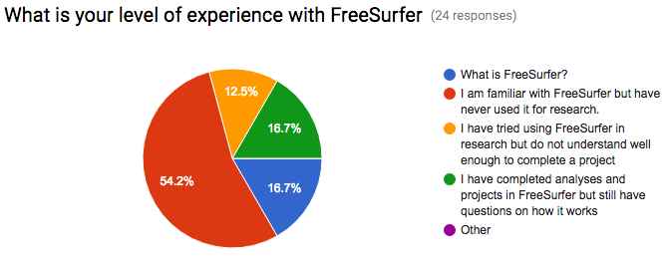
Workshop Demographics

Slide 6
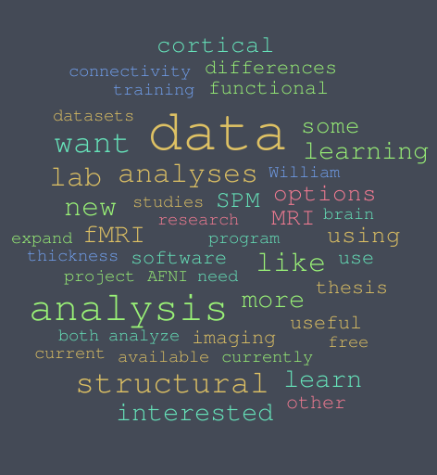

Slide 7
What is FreeSurfer?

Slide 8
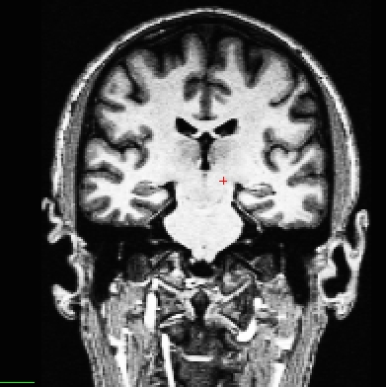
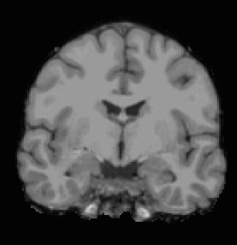
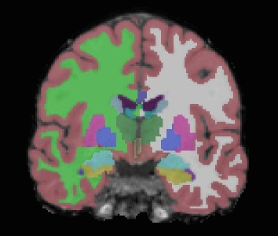
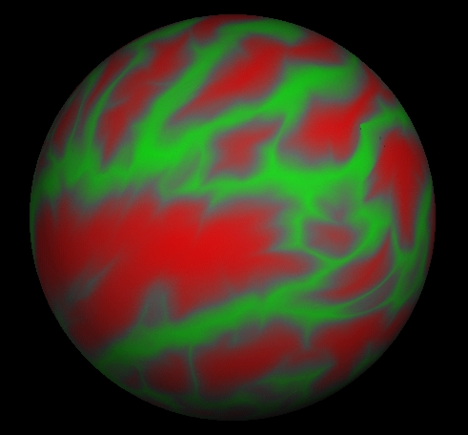
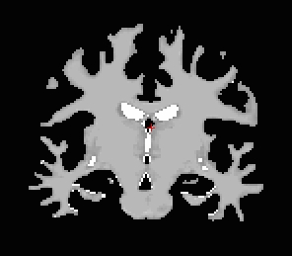
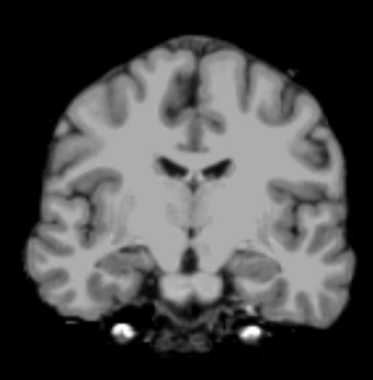
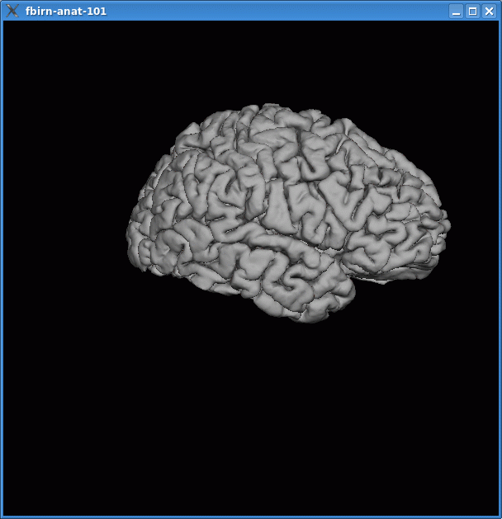
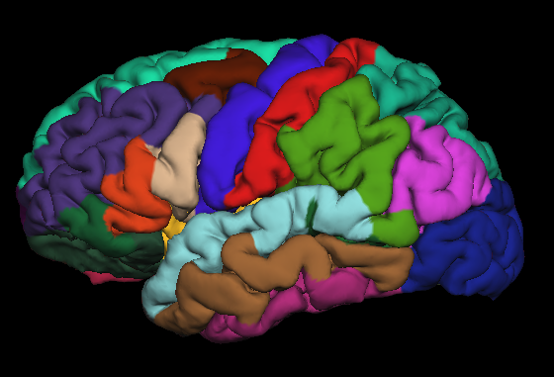
What is FreeSurfer?
Automated reconstruction of cortical surface and anatomical segmentation of brain structures from structural MRI data
Developed by Bruce Fischl, Douglas Greve and many others at the Martinos Center for Biomedical Imaging
T1 MPRAGE
Skull
Stripped
Anat.
Labeling
Surf Atlas Reg.
WM
Segment.
Intensity
Norm.
Surf Extract.
Gyral Labels

Slide 9
What can I do with FreeSurfer?
Anatomical Preprocessing
-- Image intensity normalization
-- Brain mask extraction
-- Gray, White, CSF extraction
-- Motion correction
-- Image Registration
Morphometric Analysis
-- Thickness, Curvature, Area, Volume
-- Cortical Folding
-- Tractography with DTI
fMRI Analysis
-- performed within subject space
-- tools for resting state
-- built in atlases
Longitudinal Analysis
-- nonbiased template image generation
-- mixed effects GLM modeling tools
… and much more!

Slide 10
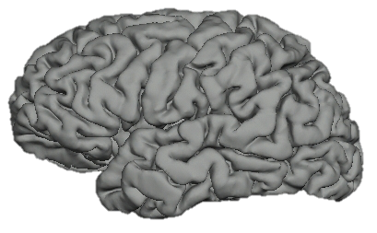
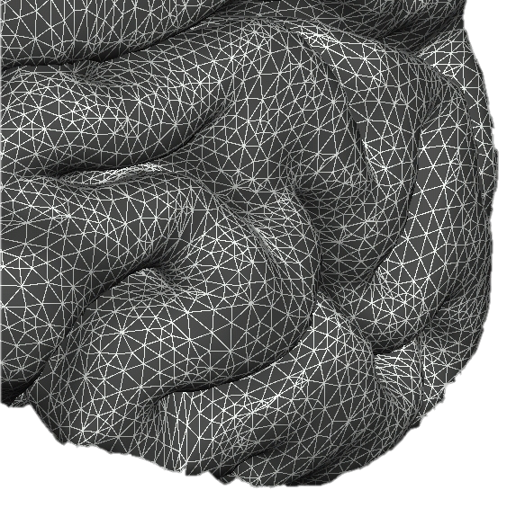
Final Product: Surface Model
Mesh (“Finite Element”)
Vertex = point of triangles
XYZ at each vertex
Triangles/Faces ~ 300,000
Area, Distance
Curvature, Thickness
Movable
14
Notes:
The cortical surface is represented by a finite element model using triangles to cover the cortical surface. The reconstruction is the (mostly automated) process of assigning an xyz to each corner of each triangle. Once the xyz of each corner of each triangle is known, then it is possible to characterize the entire cortical surface in terms of area, distance, curvature, and thickness.

Slide 11

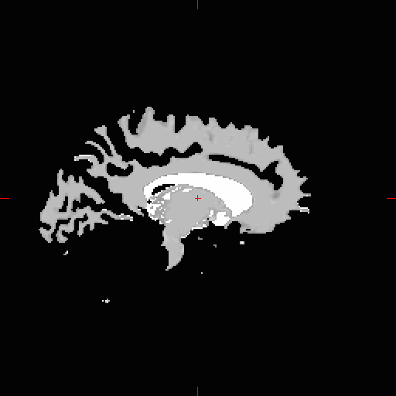
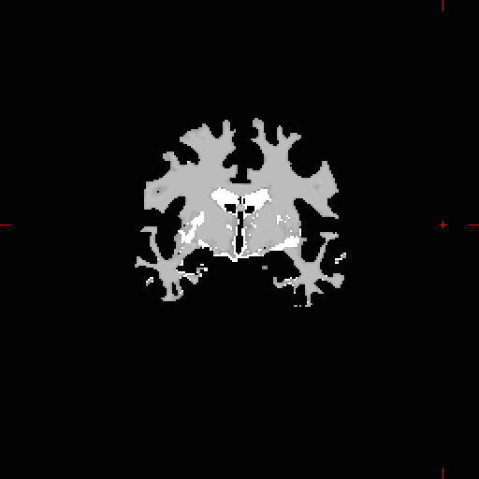
White Matter Segmentation
- Separates white matter from everything else
- Cerebellum removed, brain stem retained
11
Notes:
11

Slide 12
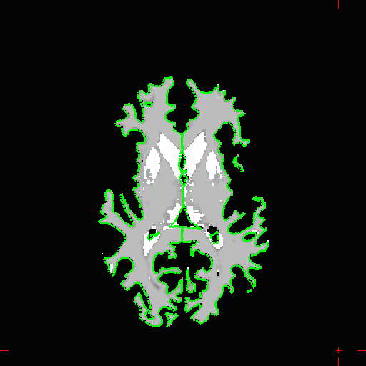
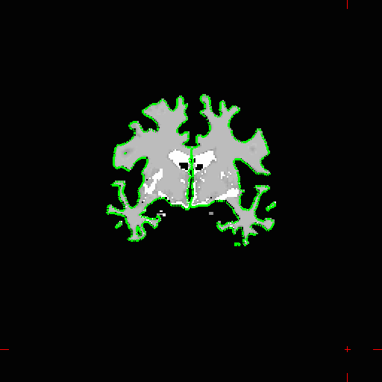
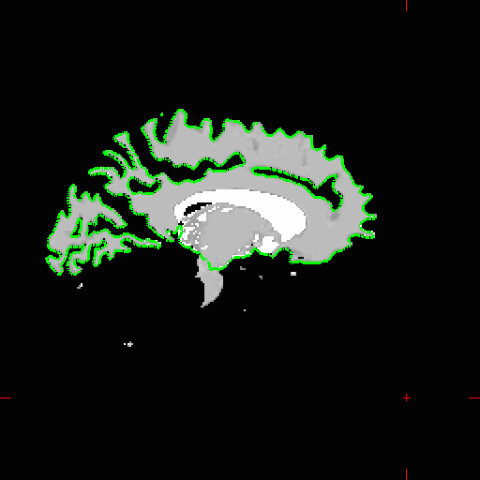
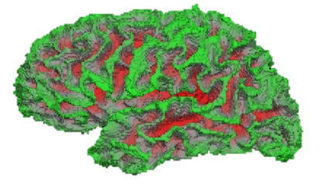
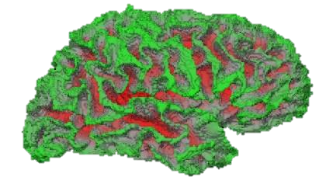
Surface Extraction
- Hemispheres separated
- Fit to wm.mgz
- 1mm resolution
- Rough, jagged
wm.mgz
lh.orig
rh.orig
Notes:
12
-label all wm, fills in ventricles and other structures based on aseg. Mask to extract wm.
Ventricles are filled in (as are the other subcortical structures).
Set of histograms in axial/horizontal plane, highest peak in each histo near center of image classified as wm (most voxels), checks across slices to make sure classification consistent, centers wm intensities on 110.

Slide 13
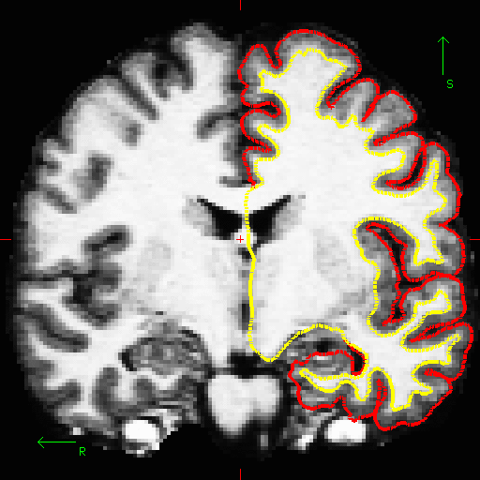
Pial Surface Estimation
Errors in pial surface placement are typically caused by underlying errors in the white matter placement, and can be corrected by interventions such as white matter control points.

Slide 14
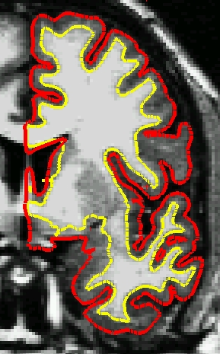
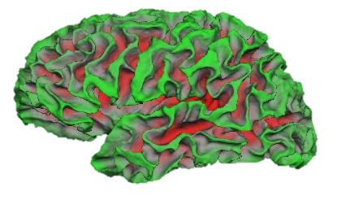
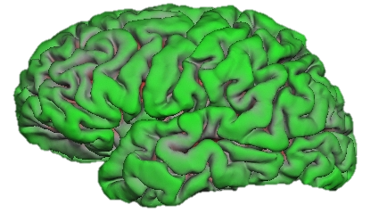
White and Pial Surfaces

Slide 15
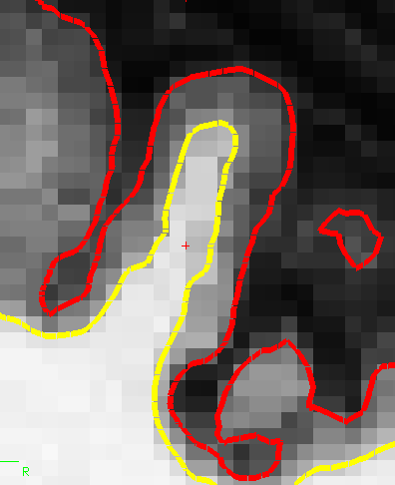
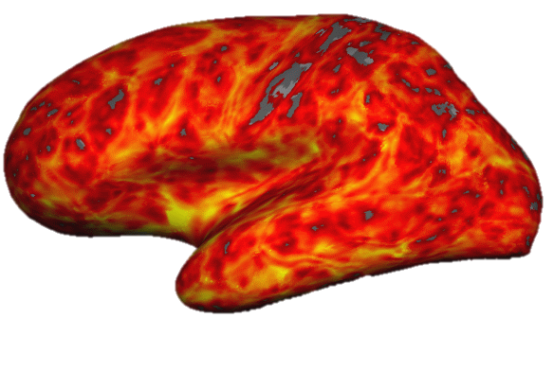
Cortical Morphometry: Thickness
pial surface

Slide 16
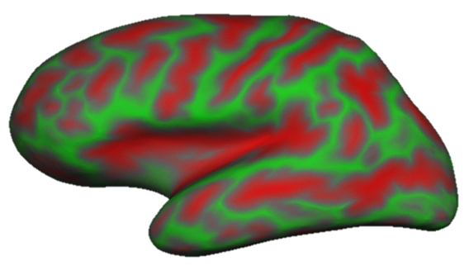
Cortical Morphometry: Curvature
Circle tangent to surface at each vertex
Curvature measure is 1/radius of circle
One value per vertex
Signed (sulcus/gyrus)
Notes:
-there is a curvature for pial surface and curvature for white surface at every vertex
Curvature = ratio , 1/radius of circle best matches what’s going on at each vertex in all directions
-indicates how curvy at each vertex (not sulcul depth).
How bumpy, nothing to do with sulci/gyri
16

Slide 17
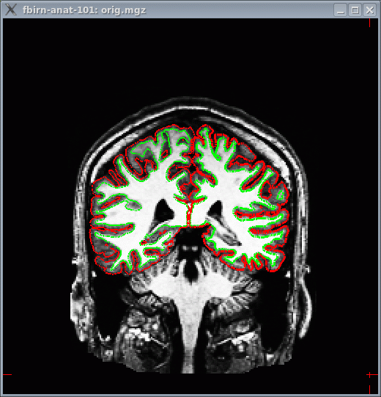
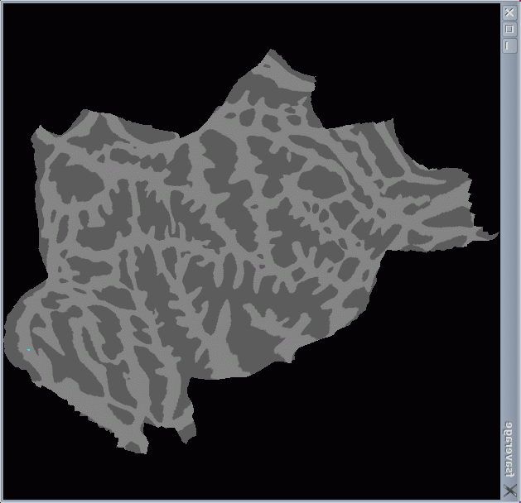
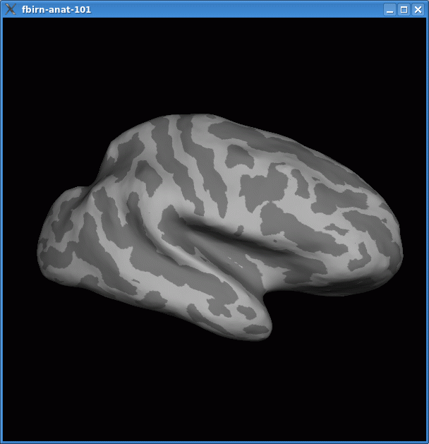
Surf(ac)ing 🏄
Inflation
Flattening

Slide 18
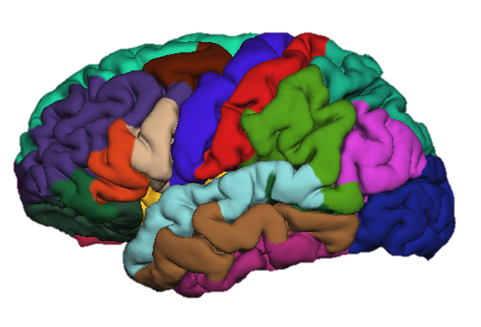
Automated Gyral Segmentation
18

Slide 19
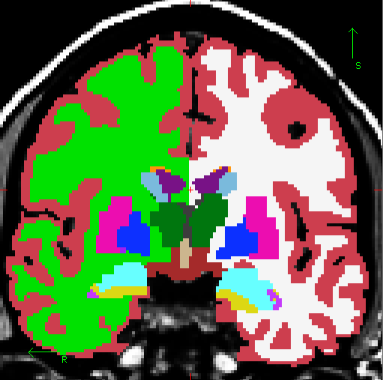
Automated Volumetric Segmentation
Cortex
Lateral Ventricle
White Matter
Thalamus
Caudate
Putamen
Pallidum
Amygdala
Hippocampus

Slide 20

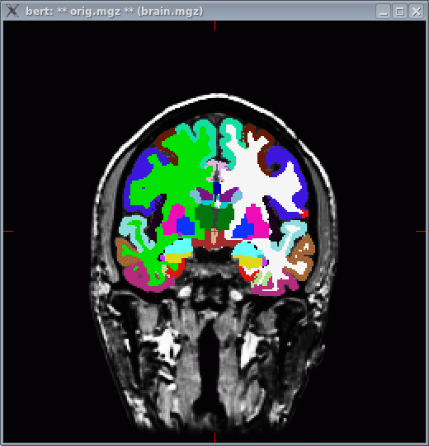
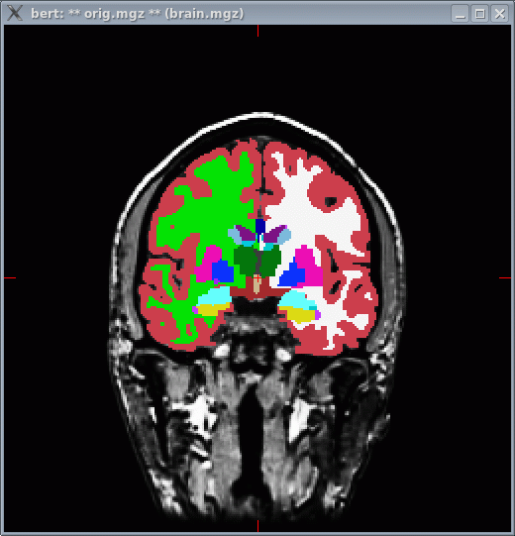
Combined Segmentations

Slide 21
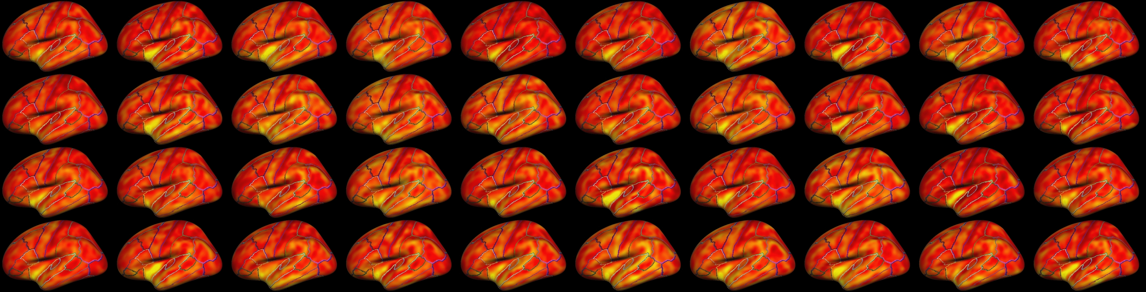
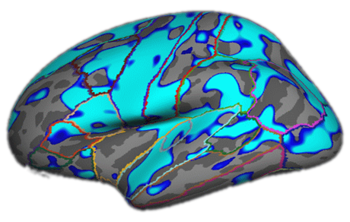
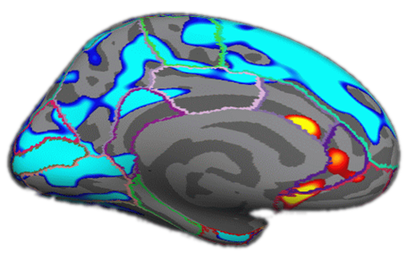
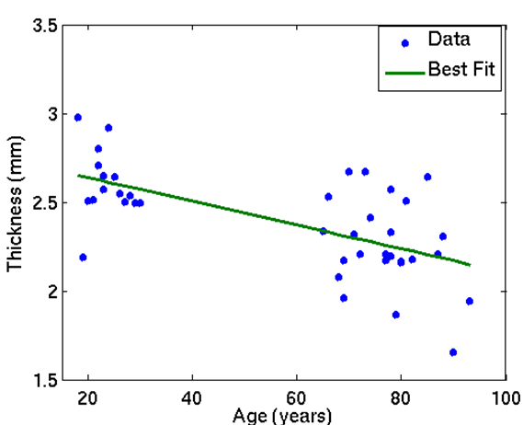
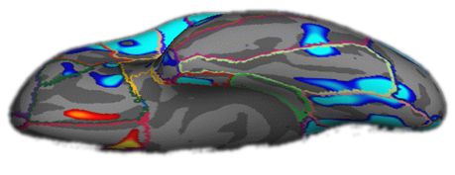
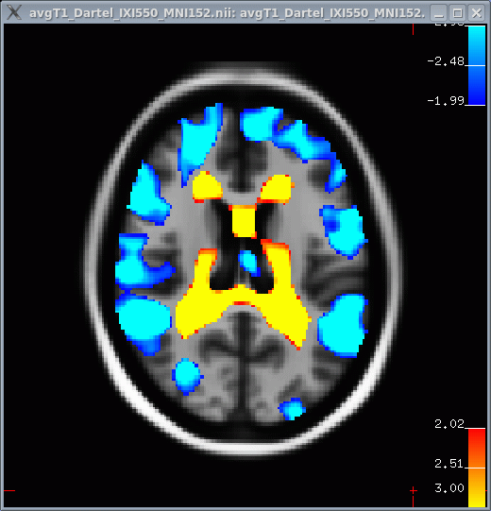
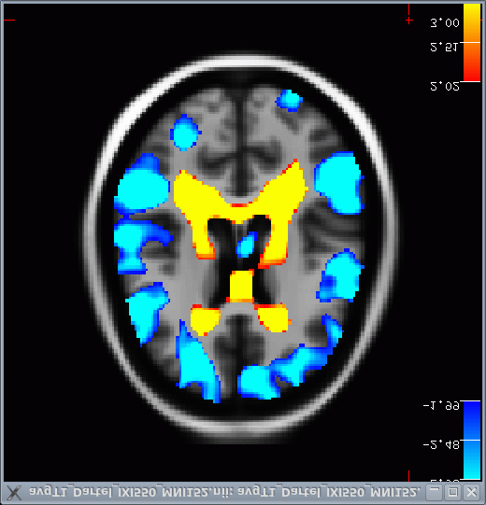
Aging Thickness Study
N=40 (all in fsaverage space)
Negative Age Correlation
Positive Age Correlation
p<.01

Slide 22
Unix Tutorial

Slide 23
I-nix, U-nix, we-all-nix!
📌 UNIX is a fundamental tool for manipulating files, tuning your system, performing network tasks, installing new software, automating routine tasks, etc.
📌 You must learn UNIX if you are serious about neuroimaging.
📌 Getting started is easy - Just open a terminal!

Slide 24
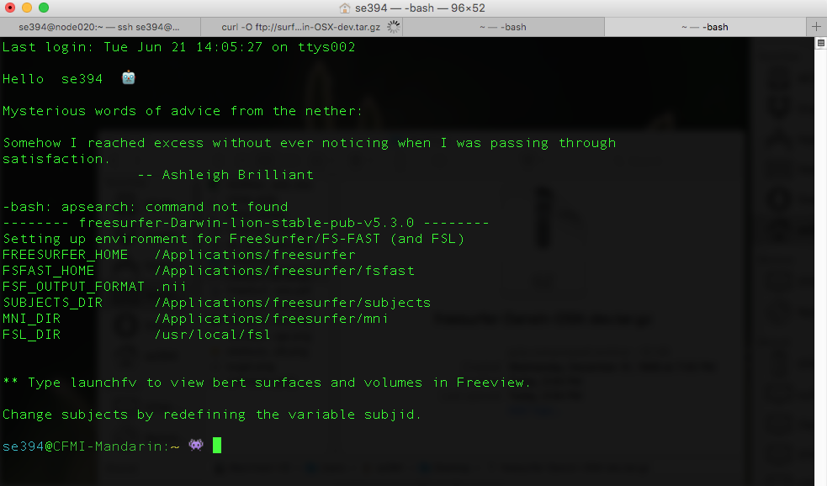
I-nix, U-nix, we-all-nix!
Default Environment Settings& Commands
set in .bash_profile
Command Prompt

Slide 25
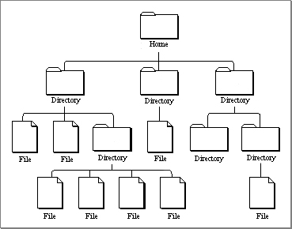
Unix :: A Hierarchical File System
Navigating File Systems
~
Basic
pwd -- print working directory
cd -- change directory
ls -- list directory contents
Advanced Usage
pushd -- save current directory
popd -- return to saved directory

Slide 26
Anatomy of a Command
command -option1 –option2 file
command - -help
command -h
man __
Try:
ls --help
or
man ls

Slide 27
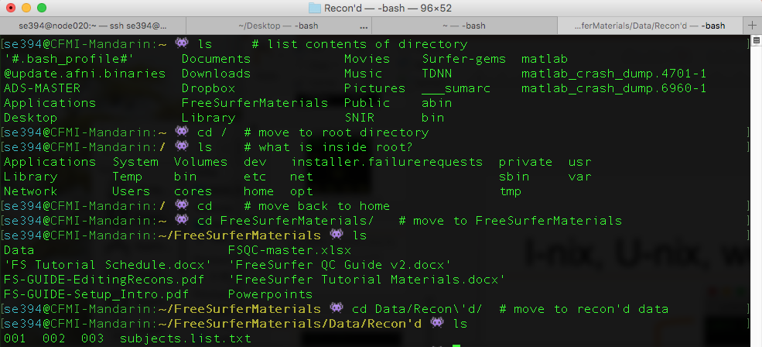
I-nix, U-nix, we-all-nix!

Slide 28
I-nix, U-nix, we-all-nix!
File Name Completion
History
Use up arrow ( ) to see previous commands
👾 ls ~/Dow # hit TAB key for autocomplete
👾 ls ~/Downloads # should autocomplete

Slide 29
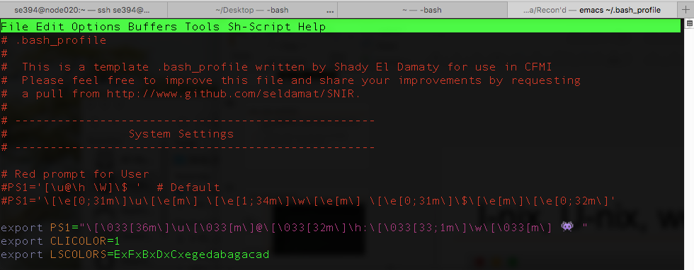
I-nix, U-nix, we-all-nix!

Slide 30
Emacs hints
Emacs is an older word processor that many people still use!
Short cuts accessed via key combinations using CONTROL and ESC keys.
Command | Key Combination
Exit emacs | CTRL + x, CTRL + c
Save work | CTRL + x, CTRL + s
Scroll down | CTRL + v
Scroll up | ESC + v
Forward one word | ESC + f
Backward one word | ESC + b
Go to line start | CTRL + a
Go to line end | CTRL + e
Beginning of sentence | ESC + a

Slide 31
Emacs hints
Emacs is an older word processor that many people still use!
Short cuts accessed via key combinations using CONTROL and ESC keys.
Command | Key Combination
End of sentence | ESC + e
Beginning of File | ESC <
End of File | ESC >
Set selection mark | CTRL + Space
Copy marked region | ESC + w
Cut marked region | CTRL + w
Paste selection | CTRL + y
Undo | CTRL + x, u

Slide 32
I-nix, U-nix, we-all-nix!
Open your .bash_profile for editing using emacs and add the following lines to customize your command prompt:
export PS1=“\[\033[36m\]\u\[\033[m\]@\[\033[32m\]\h:\[\033[33;1m\]\w\[\033[m\] 🙌 “
export CLICOLORS=1
export LSCOLORS=ExFxBxDxCxegedabagacad
cat <<EOF Welcome back $whoami EOF

Slide 33
I-nix, U-nix, we-all-nix!
Source your .bash_profile for changes to take effect
You can make a back-up copy using the cp command:
Make a folder to store it in and move the back-up file there
👾 source .bash_profile
👾 cp .bash_profile .bash_profile.bak
👾 mkdir backup-files 👾 mv .bash_profile.bak backup-files/.bash_profile.bak

Slide 34
I-nix, U-nix, we-all-nix!
Rename your folder using the mv command
Delete the files in the folder
Delete the folder (note the use of the –r option)
👾 mv backup-files mystery-folder
👾 rm backup-files/*
👾 rm –r backup-files

Slide 35
I-nix, U-nix, we-all-nix!
Sometimes you will need system permissions to execute a task or command.
If you receive an error stating that you do not have adequate permissions, try running the same command but prefixed with a sudo command.
👾 sudo touch /opt/test # make a file in a restricted folder
👾 sudo rm /opt/test # delete file in restricted folder

Slide 36
Standard Installation
Follow these instructions if MGH servers are up otherwise follow Alternative Installation

Slide 37
Materials & Resources
Google Drive (everything can be found here)
Documentation for today’s tutorial (have this printed out)
Surfer-gems (🏄 -💎)
FreeSurfer (link for FAQ & installation)

Slide 38
Quick Start Installation
Sign up for license
https://surfer.nmr.mgh.harvard.edu/fswiki/License
Retrieve Development Version (FS v6.0)
👾 cd ~ # move to home directory
👾 curl -O ftp://surfer.nmr.mgh.harvard.edu/pub/dist/freesurfer/dev/freesurfer-Darwin-OSX-dev.tar.gz

Slide 39
Quick Start Installation
Extract files from archive. Open a terminal and type,
Copy the license emailed to you and insert it into a .license file
Paste the license into emacs. Type control + x, control + c then y to save and exit.
👾 tar –xzvf freesurfer-Darwin-OSX-dev.tar #extract contents to home directory
👾 cd ~/freesurfer/ # move into freesurfer dir
👾 sudo touch .license # make an empty license file using sudo (enter password)
👾 sudo emacs .license # edit your empty file with sudo (enter password)

Slide 40
Quick Start Installation
Set environment by editing .bash_profile. In terminal type:
Enter the following statements, then exit and save
👾 cd
👾 emacs .bash_profile
export FREESURFER_HOME=”/Users/$(whoami)/freesurfer”
export SUBJECTS_DIR=“/Applications/freesurfer/subjects”
export FSF_OUTPUT_FORMAT=“.nii.gz”
source $FREESURFER_HOME/SetUpFreeSurfer.sh

Slide 41
Quick Start Installation
Source your .bash_profile for changes to take place. In terminal type:
You can also open a new terminal window for changes to take effect
Test your installation
👾 . .bash_profile
👾 tkmedit bert orig.mgz

Slide 42
Alternate Installation
Addressing Technical Difficulties

Slide 43
Alternate Installation
Navigate to Google Drive
https://drive.google.com/drive/u/1/folders/0B3BO1Fk34wFhbnBCQkJlYkhfemc
Add to Drive, Open in Drive
Download Development Version (FS v6.0)
- navigate to FreesurferDownloads
- right click and download relevant version (this takes time)

Slide 44
Alternate Installation
Download & extract FreeSurfer tutorial data (found under FreesurferDownloads)
Download Data directory
Download Presentations directory
Download documentation & schedule
👾 tar -C $FREESURFER_HOME/subjects -xzvf /path/to/tutorial_data*.tar.gz

Slide 45
Alternate Installation
Make directory and extract files from archive. Open a terminal and type,
Set environment by editing .bash_profile. In terminal type:
👾 mkdir ~/freesurfer
👾 tar -C ~/freesurfer -xzvf /path/to/freesurfer_*.tar.gz
👾 cd
👾 emacs .bash_profile

Slide 46
Alternate Installation
Enter the following statements, then exit and save
Be sure to type these commands exactly as indicated
export FREESURFER_HOME=”/Users/$(whoami)/freesurfer”
export SUBJECTS_DIR=“/Applications/freesurfer/subjects”
export FSF_OUTPUT_FORMAT=“.nii.gz”
source $FREESURFER_HOME/SetUpFreeSurfer.sh
export TUTORIAL_DATA=“$FREESURFER_HOME/subjects/tutorial_data”

Slide 47
Extended Installation
The following software is required for extended functionality
FSL
AFNI
MacPorts
MATLAB

Slide 48
🏄 -💎 → 🖥
Open Terminal
Add 🏄 -💎 to your path by adding the following line to .bash_profile
Source your .bash_profile
👾 cd
👾 git clone https://github.com/seldamat/Surfer-gems.git
export PATH=“/Users/$whoami/Surfer-gems:$PATH”
👾 . ~/.bash_profile

Slide 49
🏄 -💎 → 🖥
Test installation
Information about this repository found in README.md
FreeSurfer documentation can be found under doc directory
Keep your repo up to date by regularly pulling changes (click for more info on git)
👾 FSQC-check -h

Slide 50
Tutorial Data
Download all materials here
Contains the following
Data (tutorial data, raw and recon’d)
Powerpoints (resources taken from FreeSurfer site)
FS Tutorial Schedule.doc
FS-GUIDE-EditingRecons.pdf
FS-GUIDE-Setup&Intro.pdf
Read this!!

Slide 51
Exercises

Slide 52
Exercise 1. Running a Recon
Reconstruct a single subject using the recon-all command.
Open a terminal window, your SUBJECTS_DIR should be printed near the top of the screen when you log in. Set your SUBJECTS_DIR to the tutorial data.
👾 SUBJECTS_DIR=“/Users/$(whoami)/FreeSurferMaterials/FSQC-tutorial”
👾 echo $SUBJECTS_DIR #print directory to screen
👾 mkdir $SUBJECTS_DIR #make a new directory if it doesn’t exist
👾 cd $SUBJECTS_DIR #move to directory to test it was created
👾 cd #back to home directory

Slide 53
Exercise 1. Running a Recon
Reconstruct a single subject using the recon-all command.
Import the subject’s data
Confirm import into directory structure
Run recon-all command
👾 recon-all –s 001 –i “FreeSurferMaterials/Data/Raw/001/Anat-1/Anat-00001.nii”
👾 ls $SUBJECTS_DIR/001/
👾 recon-all –s 001 -all

Slide 54
Exercise 2. Running a Recon Batch
Reconstruct a batch of subjects using the recon-all command.
Use the wraper for recon-all! Check usage first
Run a batch
👾 recon-all-go -h
👾 recon-all-go –rd “/Users/$(whoami)/FreeSurferMaterials/Data/Raw/” –rf “.nii”

Slide 55
Exercise 3. QC Summary for Completed Subject
How to gauge the quality of your recon? Print QC statistics!
First set your SUBJECTS_DIR to already processed data
Next inspect FSQC-summary for usage information
Input the command!
👾 SUBJECTS_DIR=”/Users/$(whoami)/FreeSurferMaterials/Data/Recon\’d/”
👾 FSQC-summary -h
👾 FSQC-summary –sub 001 –outdir ~/FreeSurferMaterials/FSQC-tutorial/QC

Slide 56
Exercise 4. QC Summary for Subject Batch
QC summaries for a batch of subjects can be generated with FSQC-check
Run this on the tutorial data set, indicate output folder
Inspect your results
👾 FSQC-check -h
👾 FSQC-check –qd ~/FreeSurferMaterials/FSQC-tutorial/QC
👾 ls ~/FreeSurferMaterials/FSQC-tutorial/QC/*

Slide 57
Exercise 5. Viewing a Subject’s Results
The FreeView application is a great way to view your subject’s data.
However, loading every surface and volume can be time consuming.
Use the launchfv program to quickly load a subject
Check usage for more information
👾 launchfv –sub 002

Slide 58


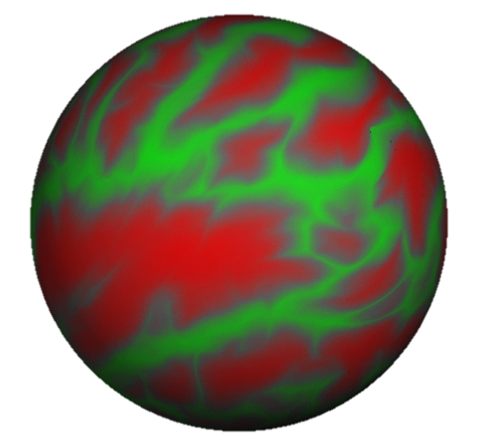


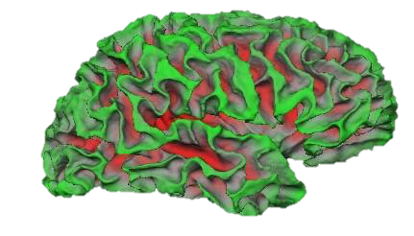
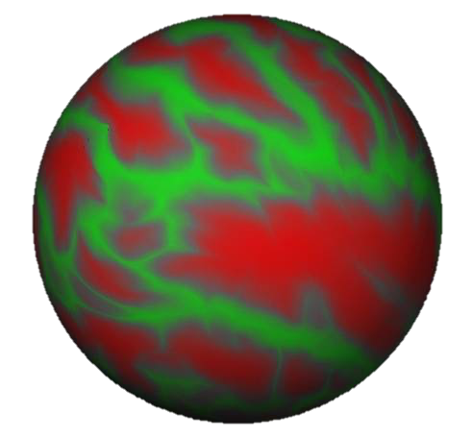
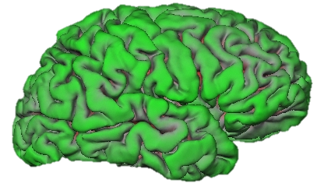
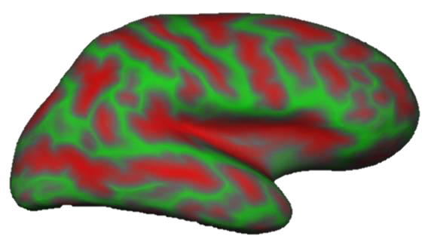
Upon Completion…
<subname>
scripts mri surf label stats
lh.orig
lh.white
lh.pial
lh.inflated
lh.sphere.reg
rh.orig
rh.white
rh.pial
rh.inflated
rh.sphere.reg
lh.thickness and rh.thickness, ?h.curv, ?h.sulc
Notes:
58
-bert is ID, dirs underneath bert created automatically.
-Most important ones: stats, mri, scripts(logs)
-a lot of files stored here are in a format called…

Slide 59




Upon Completion…
<subname>
scripts mri surf label stats
lh.aparc.annot
lh.aparc.a2009s.annot
rh.aparc.annot
rh.aparc.a2009s.annot
Desikan/Killiany Atlas
Destrieux Atlas
59
Notes:
59
-bert is ID, dirs underneath bert created automatically.
-Most important ones: stats, mri, scripts(logs)
-a lot of files stored here are in a format called…

Slide 60
Upon Completion…
<subname>
scripts mri surf label stats
aseg.stats – subcortical volumetric stats
wmparc.stats – white matter segmentation volumetric stats
lh.aparc.stats – left hemi Desikan/Killiany surface stats
rh.aparc.stats – right hemi Desikan/Killiany surface stats
lh.aparc.a2009.stats – left hemi Destrieux
rh.aparc.a2009.stats – right hemi Destrieux
stats files are text files with summary information, eg:
volume of left amygdala
average thickness in superior temporal gyrus
Notes:
60
-bert is ID, dirs underneath bert created automatically.
-Most important ones: stats, mri, scripts(logs)
-a lot of files stored here are in a format called…

Slide 61
Exercise 6. Generate Statistics Files
FreeSurfer generates ROI statistics using the different atlases that are packaged with the software. The ROI statistics across subjects can be collected and appended into a single data file using the FS-stats command.
This command can be quite flexible. Check the usage for more info.
👾 FS-stats

Slide 62
Questions?
Take the remaining time to explore on your own!

